Slide 1
Kindergarten Curriculum
Welcome to kindergarten! Your child will learn and grow SO much this school year!
It’s an exciting time!

Slide 2
Approximate Kindergarten Schedule
Arrival
Morning Meeting
Writer’s Workshop
Phonemic Awareness/Heggerty
Snack
Literacy Centers
Specials
Lunch
Reading Block
Math Block
Recess
Science/Social Studies
Dismissal

Slide 3
Writing
Writer’s Workshop Framework
Mini-Lesson (5-7 minutes)
Instruction includes the delivery of one specific teaching point
Students have an assigned partner
During the active involvement portion, the teacher “listens in” as the partners turn and talk
Students are sent to their desks to write
Independent Writing & Conferring (15-20 minutes)
Students are consistently working on self-selected pieces
The teacher should confer with each student a minimum of once per week
Individual conferences last 3-5 minutes
Using their phonics knowledge to apply letter sounds to their stories is encouraged and expected as they develop writing skills.
At the end of each unit of study, we will have an “in class” celebration where we “publish” our favorite stories.
We also try to incorporate writing prompts from our Flyleaf reading program.

Slide 4
When we know better, we do better!
Science of Reading
Evidence-Based
Instruction
Notes:
At Antioch Elementary, we want every child to be successful in reading! Our teachers are involved in a two-year rigorous professional development course called LETRS- or Language Essentials for Teachers of Reading and Spelling. We are learning the “Science of Reading” or what the research says about how children learn to read. We are using this knowledge to plan and deliver effective instruction and intervention to support all students. The research is telling us that while reading is more challenging for some students than others, with evidence-based reading instruction, nearly every child can become proficient by the end of 3rd grade. This means that we are in transition as we change instructional programs and practices moving from a balanced literacy approach to a structured literacy approach. Now that we know better, we can do better for each and every student!

Slide 5
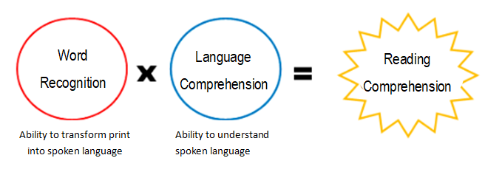
The Simple View of Reading
(Gough and Tunmer, 1986)
Notes:
The Simple View of Reading serves as a framework for assessment and instruction for us. Although learning to read is not simple, this equation helps us to think about what is needed for a student to become a successful reader in a simple way. A successful reader has reading comprehension. That is our goal. But in order to reach that goal of reading comprehension, we must be able to do two important things. We have to read the words on the page. We call this word recognition or the ability to transform print into spoken language. AND we also have to be able to understand what those words mean. We call this language comprehension or the ability to understand spoken language. Both of these components must be in place for our children to become readers.

Slide 6
The Essential Components
of Reading Instruction
Notes:
Based on the National Reading Panel Report, we know that all children benefit from direct, explicit, systematic reading instruction in the five essential components of reading.
Phonemic Awareness is the ability to notice, think about, or manipulate the individual sounds in words.
Phonics is the study of the relationships between letters and the sounds they represent;
Vocabulary is the knowledge of and memory for word meanings learned both directly and indirectly.
Fluency is the ability to read text quickly, accurately, and with proper expression. Fluency provides a
bridge between word recognition and comprehension
Comprehension is understanding what one is reading, and the ultimate goal of all reading activity
Classroom instruction will include these areas as well as writing, speaking, and listening.

Slide 7
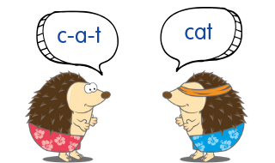
Heggerty
Heggerty is a Phonemic Awareness curriculum approach used as a peice of our kindergarten literacy program. The length these of these lessons are between 7-10 minutes each day. Phonemic Awareness is the understanding that spoken words are made up of individual sounds, which are called phonemes. A child who is phonetically aware is able to recognize rhyming words, create word families, isolate sounds, manipulate sounds, blend and segment the sounds into spoken and written words.

Slide 8
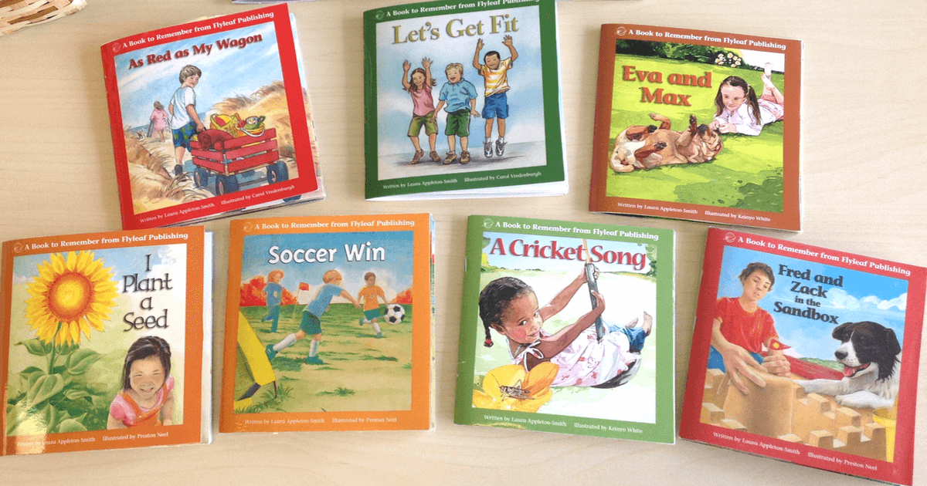
Flyleaf
Flyleaf is a decodable text reading program designed to allow readers with abundant opportunities to transfer their newly phonics knowledge to meaningful, engaging, complex narratives, and informational texts. We incorporate this alongside our Heggerty Phonemic Awareness program and blend it with the independent reading time of Reader’s Workshop.

Slide 9
Literacy Centers
Literacy-Based Activities, also known as Daily Five.
Includes:
Handwriting
Word Work & Phonics
Listening
Reading
Writing

Slide 10
Math
Math includes five Mathematical strands:
Counting and Cardinality: Counting, Comparing numbers and sets, Ordering numbers and sets
Numbers and Operations-Base 10: Work with numbers 11-19; lays the foundation for place value
Measurement and Data: Describe and compare measurable attributes, classifying
Operations and Algebraic Thinking: Understand addition as “putting together” and adding to, understand subtraction as “taking apart” and/or taking from
Geometry: Identify and describe 2-D shapes (squares, circles, triangles, rectangles, hexagons, rhombus, trapezoid). Identify 3-D shapes (cubes, cones, cylinders, spheres). Analyze, compare, and create shapes from other shapes

Slide 11
Science & Social Studies
Science
Units of study:
Position and Motion
Weather
Living Things
Properties of Matter
Social Studies
Units of study:
I am a Citizen
Cultures Around Us
What’s in the World Around Me?
We Have Needs, We Have Wants

Slide 12
Home/School Communication
Please be sure to check your child’s take home folder every night. Also be sure to sign your child’s calendar daily.
(Some of these requests can be teacher specific…)
Transportation Changes- If your child needs to go home a different way than normal, please send in a note to your child’s teacher, or you can email the front office: rhonda.young@ucps.k12.nc.us
Please let your child’s teacher know about any allergies/health issues your child may be experiencing.

Slide 13
Breakfast/Snack/Lunch
Breakfast
If you would like your child to have breakfast at school in the mornings, please teach your child to go to the cafeteria BEFORE they come to their classrooms. Our staff will assist your child to the cafeteria to get their breakfast. Breakfast is served in the Cafeteria from 7:00-7:20am.
Snack
Every day, as healthy as possible, please send your child with a snack. Please make sure it is packed separately from their lunch. NO SNACKS IN LUNCH BOXES. Thank you! Also, if you can, please write your child’s name on it. Thanks!
Lunch
It would be helpful if your child memorized their lunch number as well as practice opening containers and food items. Desserts are only allowed to be purchased on Thursdays, and your child must have money in their account to get dessert!

Slide 14
Please email your child’s teacher with any questions or concerns!

